Slide 1

Gradient Boosting and Ensemble technique in Machine Learning
Presented by :-
Hrishikesh Deshpande
ADS

Slide 2
What is Ensemble technique ?
Ensemble technique is a technique which uses multiple weak learners to produce a strong model for regression and classification.
In ensemble learning, many base models like classifiers and regressors are generated and combined together so that they give better results.
And here in Gradient boosting each predictor is trained using the residual errors of predecessor as labels instead of using directly labels to train our model.

Slide 3
What is weak learner ?
Weak learners are the models which is used sequentially to reduce the error generated from the previous models and to return a strong model in the end.
Decision trees are used as weak learner in gradient boosting algorithm.

Slide 4
What are the different types of ensemble techniques ?
The three most popular methods for combining the predictions from different models are:
1. Bagging. Building multiple models (typically of the same type) from different subsamples of the training dataset.
2. Boosting. Building multiple models (typically of the same type) each of which learns to fix the prediction errors of a prior model in the sequence of models.
3. Voting. Building multiple models (typically of differing types) and simple statistics (like calculating the mean) are used to combine predictions.

Slide 5
What is Gradient Boosting ?
Gradient Boosting is an supervised machine learning algorithm used for classification and regression problems.
Gradient Boosting is a popular boosting algorithm. In gradient boosting, each predictor corrects its predecessor’s error or residual error.
It is an ensemble technique which uses multiple weak learners to produce a strong model for regression and classification.
Here each predictor is trained using the residual errors of predecessor as labels.

Slide 6
Each tree predicts a label and final prediction is given by the formula,
We uses decision tree here for process.
For Residual,
Residual = Actual value – Predicted Value
Final formula :-

Slide 7
What are the steps of gradient boosting ?
1. Calculate the average/mean of the target variable.
2. calculate the residuals for each sample.
Residual = Actual Value - Predicted Value
3. use decision tree algorithm to train the model considering residual as label . We build a tree with the goal of predicting the Residuals.
4. Repeat steps 3 to 5 until the number of iterations matches the number specified by the hyper parameter(numbers of estimators)

Slide 8
5. Once trained, use all of the trees in the ensemble to make a final prediction as to value of the target variable.
The final prediction will be equal to the mean we computed in Step 1 plus all the residuals predicted by the trees that make up the forest multiplied by the learning rate.
final prediction = Average Price + LR*Residual predicted by DT1 + LR*Residual Predicted by DT2 + .......LR*Residual Predicted by DT N
Here,
LR = Learning rate
DT = Decision tree

Slide 9
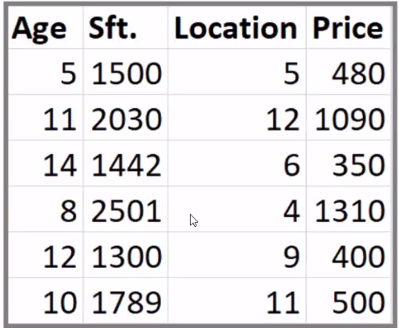
Given dataset : Gradient Boosting working :

Slide 10
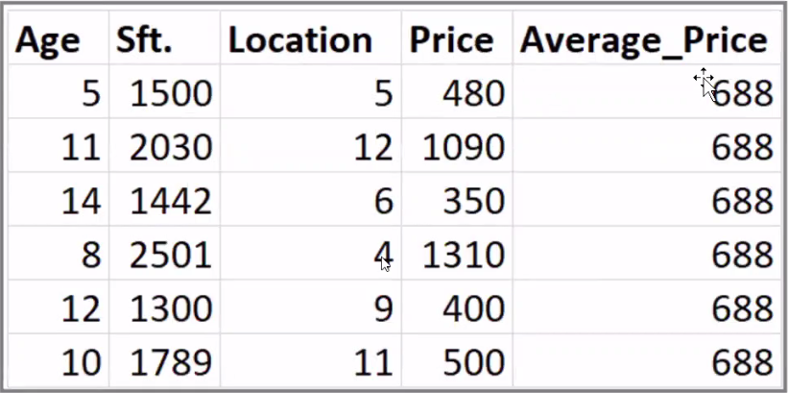

Slide 11
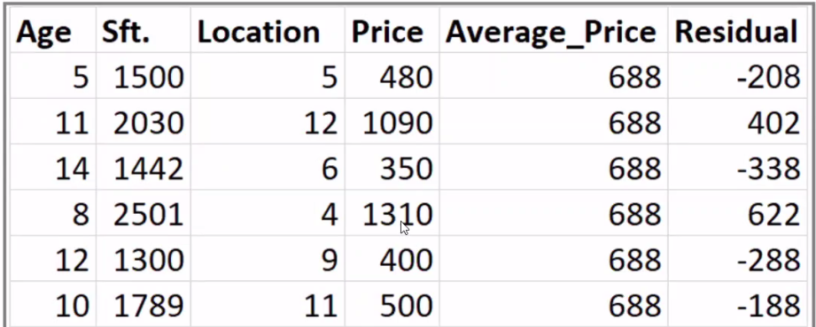

Slide 12
XGBoost Algorithm or Extreme gradient boosting :
XGBoost is an advanced implementation of gradient boosting along with some regularization factors
XGBoost or extreme gradient boosting is one of the well-known boosting techniques(ensemble) having enhanced performance
and speed in tree-based (sequential decision trees) machine learning algorithms.
Earlier only python and R packages were built for XGBoost but now it has extended to Java, Scala, Julia and other languages as well.
The main benefit of the XGBoost implementation is computational efficiency and often better model performance.

Slide 13
The main benefit of the XGBoost implementation is computational efficiency and often better model performance.
XGBoost falls under the category of Boosting techniques in Ensemble Learning.
Ensemble learning consists of a collection of predictors which are multiple models to provide better prediction accuracy.
In Boosting technique the errors made by previous models are tried to be corrected by succeeding models by adding some weights to the models.

Slide 14
Features of XGBoost :
Can be run on both single and distributed systems(Hadoop, Spark).
XGBoost is used in supervised learning(regression and classification problems).
Supports parallel processing.
Cache optimization.
Efficient memory management for large datasets exceeding RAM.
Has a variety of regularizations which helps in reducing overfitting.
Can handle missing values.
Has inbuilt Cross-Validation.

Slide 15
Thank you !!!

